Slide 1


Good morning Everyone! welcome to discussion of spiral model
by Samyog Khadka

Slide 2
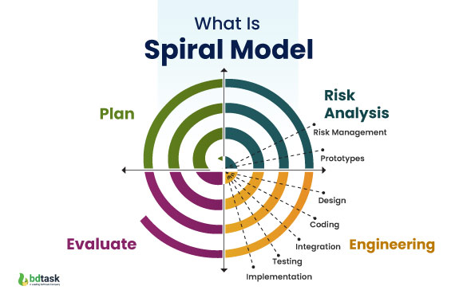
The Spiral Model in Software Development
The Spiral Model is a risk-driven approach for building software systems. It combines iterative development with systematic aspects of traditional Waterfall models. This presentation explores its key features, benefits, and challenges in modern software engineering.

Slide 3

Introduction to the Spiral Model
1
2
Definition
Purpose
Introduced by Barry Boehm in 1986, the Spiral Model combines iterative development with Waterfall aspects.
Manages project risks by breaking the process into smaller, manageable parts with regular assessments.
3
Key Features
Focuses on risk management, iterative development cycles, and combines design with prototyping.

Slide 4
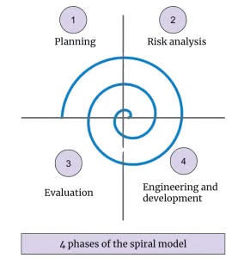
Detailed Description of the Spiral Model
1
Planning
Identify objectives, constraints, and alternatives for the project iteration.
2
Risk Analysis
Assess risks and develop solutions, including prototypes or alternative approaches.
3
Engineering
Develop and build the product based on the planning and risk analysis.
4
Evaluation
Review progress, test the product, and gather feedback for the next iteration.

Slide 5

Pros of the Spiral Model
1.Risk Management
2.Flexibility
3.Customer Involvement
Early detection and mitigation of risks.
Continuous evaluation ensures risk assessment at every stage.
Adaptable to changes during development.
Ideal for large, complex, and high-risk projects.
Feedback collected after each iteration improves customer satisfaction.
Early prototyping enables testing and refinement.

Slide 6

Cons of the Spiral Model
1.Complexity
2.Resource Intensive
Requires skilled project management and deep understanding of the model.
Can be difficult without experienced personnel.
Continuous risk assessment and management require significant time and resources.
More costly due to frequent iterations.
3.Not Ideal for Small Projects
Overkill for simple, small-scale projects due to its complexity.
Difficult to define phases for fixed requirements.

Slide 7


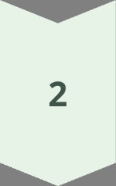
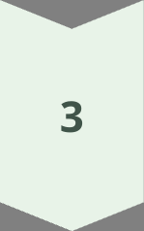
Conclusion
Structured Flexibility
Offers a structured yet flexible approach to software development.
Risk Management Focus
Strong emphasis on managing risks and incorporating user feedback.
Best Use Cases
Ideal for large, complex projects with unclear or changing requirements.

Slide 8

Thank You!

